Slide 1
BIG-MART SALES
Analyze and Prediction
Veeri Dheeraj

Slide 2
ABOUT BIG-MART
The Big Mart is an International Brand. Big Mart Brand has started its journey in 2007 with free home delivery services of food and grocery.
Big Mart (Big Mart Retail Corporation and White Blue Retail) is one of the fastest growing express home delivery food and grocery company covering worldwide which is incorporated in the year 2016.
In the years of 2009 big mart started its operation through its retail store on small size 100 sft. to 300 sft. area. big mart is giving door step delivery to its customer through our retail stores .

Slide 3
WHY BIG-MART ?
COST EFFECTIVE
franchisee
Provides goods or products for effectively low price and more offers.
Easy to setup a new store at a affordable price.
Online
Trust
Provides easy access in the online shopping.
More than 20 years of journey it gained a lot of trust in customers and their goal is to value for the stakeholders are our major goals which we try to fulfill with our four pillars.
DELIVERY
Due to its long history it guarantee on time delivery, and the best quality to customers.

Slide 4
SOLUTION
DATA Cleaning
Prediction
Cleaning our data by removing null values, unwanted variables, filling empty variables with appropriate values.
By using Linear regression and XG boost model we will do prediction for given data.
Visualization
Conclusion
Analyzing and visualizing our data using appropriate graphs.
By all these methods we will tell what are the insights of the data and future prediction.

Slide 5
Project OVERVIEW
When we want to analyse our data or for data pre-processing the data should be divided into train and test sets so that we can improve the performance of our data.
Train
TEST
The training data is the biggest (in -size) subset of the original dataset, which is used to train or fit the machine learning model.
Represent or part of the original dataset.
It should be large enough to give meaningful predictions.
Once we train the model with the training dataset. This dataset evaluates the performance of the model and ensures that the model can generalize well with the new or unseen dataset.
The test data is another subset of the original data, which is independent of training dataset.

Slide 6
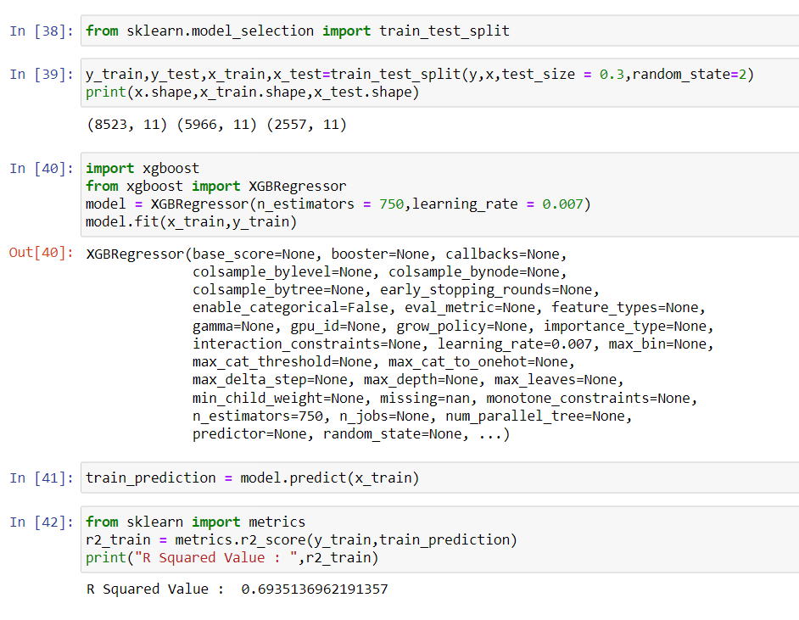
XG BOOST
It is used for Regression Model.
Which is used to calculate the R-Squared value for our data.
And it is used for the predictive analysis.
If the R-Squared value is high then it represents a good model.
Coefficient of multiple determination is used for the multiple regression.

Slide 7
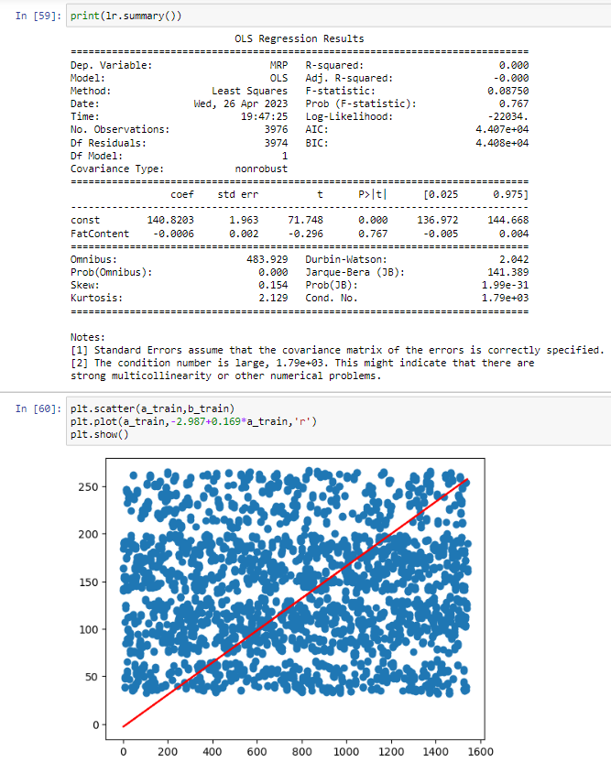
Linear regression
Best-Fit line for predictive analysis
Linear regression algorithm shows a linear relationship between a dependent (y) and one or more independent (y) variables, hence called as linear regression.
Linear Regression is a machine learning algorithm based on supervised learning. It performs a regression task.
Regression models a target prediction value based on independent variables.
In this project we find our prediction for outlet sales using independent variables such as MRP, Fat Content, Outlet size etc.…

Slide 8
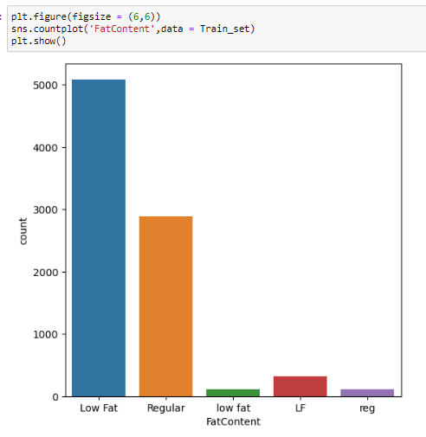
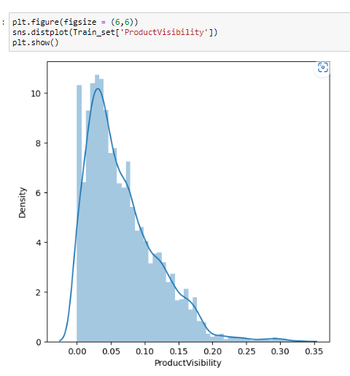
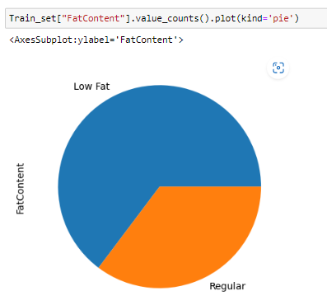
Visualization
Count plot
Dist-plot
Pie chart
Returns the count based off a categorical column, we need to specify only the x parameter.
Shows the density and histogram of the given variable.
The graph's pieces are equal to the percentage of the total in each group.

Slide 9
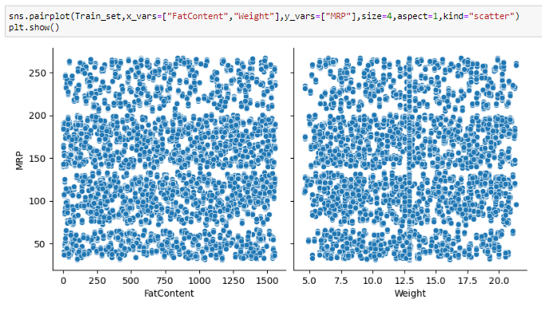
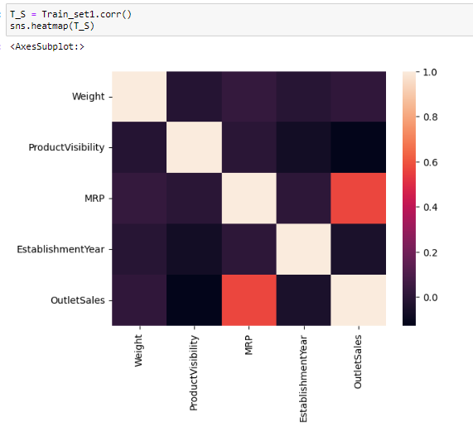
Visualization
Scatter plot
Correlation
Scatter plots are the graphs that present the relationship between two variables in a data-set.
A correlation heatmap is a heatmap that shows a 2D correlation matrix between two discrete dimensions.

Slide 10
conclusion
By performing all these models to our dataset we can conclude that –
Sales for the train data depends upon the Location.
Sales are high for the products which has low fat content.
outlet sales does not depends upon the outlet size but it will depend upon the outlet type.
Big-Mart with medium size has more sales.
From the Linear Regression graph we can clearly see that the MRP increases in the future when there is increase in products which has low Fat Content.
Due to increase in MRP the Outlet Sales will be automatically increased.

Slide 11
THANK YOU
Veeri Dheeraj
12012614
RK20KTA21
K20KT

